Slide 1
COT5615: Math for Intelligent Systems I
Anand Rangarajan
Lecture 24

Slide 2
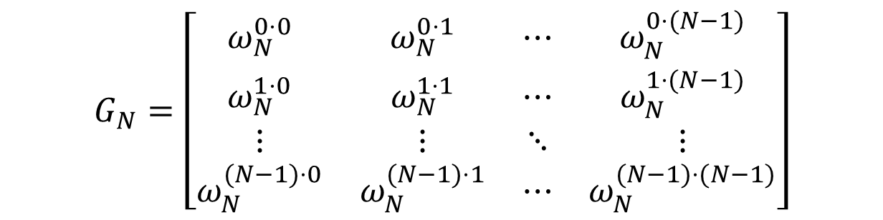



The Fourier Transform Matrix $G_{N}$
$$G_{N}=\left[\begin{matrix}ω_{N}^{0⋅0} & ω_{N}^{0⋅1} & ⋯ & ω_{N}^{0⋅(N−1)} \\ ω_{N}^{1⋅0} & ω_{N}^{1⋅1} & ⋯ & ω_{N}^{1⋅(N−1)} \\ ⋮ & ⋮ & ⋱ & ⋮ \\ ω_{N}^{(N−1)⋅0} & ω_{N}^{(N−1)⋅1} & ⋯ & ω_{N}^{(N−1)⋅(N−1)}\end{matrix}\right]$$
$$ω_{N}=\exp\left\{−\frac{i2π}{N}\right\}$$
$G_{N}$ is complex and symmetric (NOT HERMITIAN). ${\left\{G_{N}\right\}}_{kl}={\left\{G_{N}\right\}}_{lk}$
Therefore $G_{N}^{−1}=\frac{1}{N}\overline{G_{N}^{T}}=\frac{1}{N}\overline{G_{N}}$

Slide 3





The Unit Circle in the Complex Plane
$$i=ω^{−1}=ω^{−5}=ω^{−9}⋯$$
$$\frac{2π}{4}$$
$$⋯ω^{−10}=ω^{−6}=ω^{−2}=−1$$
$$1=ω^{0}=ω^{−4}=ω^{−8}⋯$$
$$−i=ω^{−3}=ω^{−7}=ω^{−11}⋯$$
Roots of unity $ω_{N}^{k}=\exp\left\{\frac{−i2πk}{N}\right\}$ in the complex plane for $n=4$

Slide 4
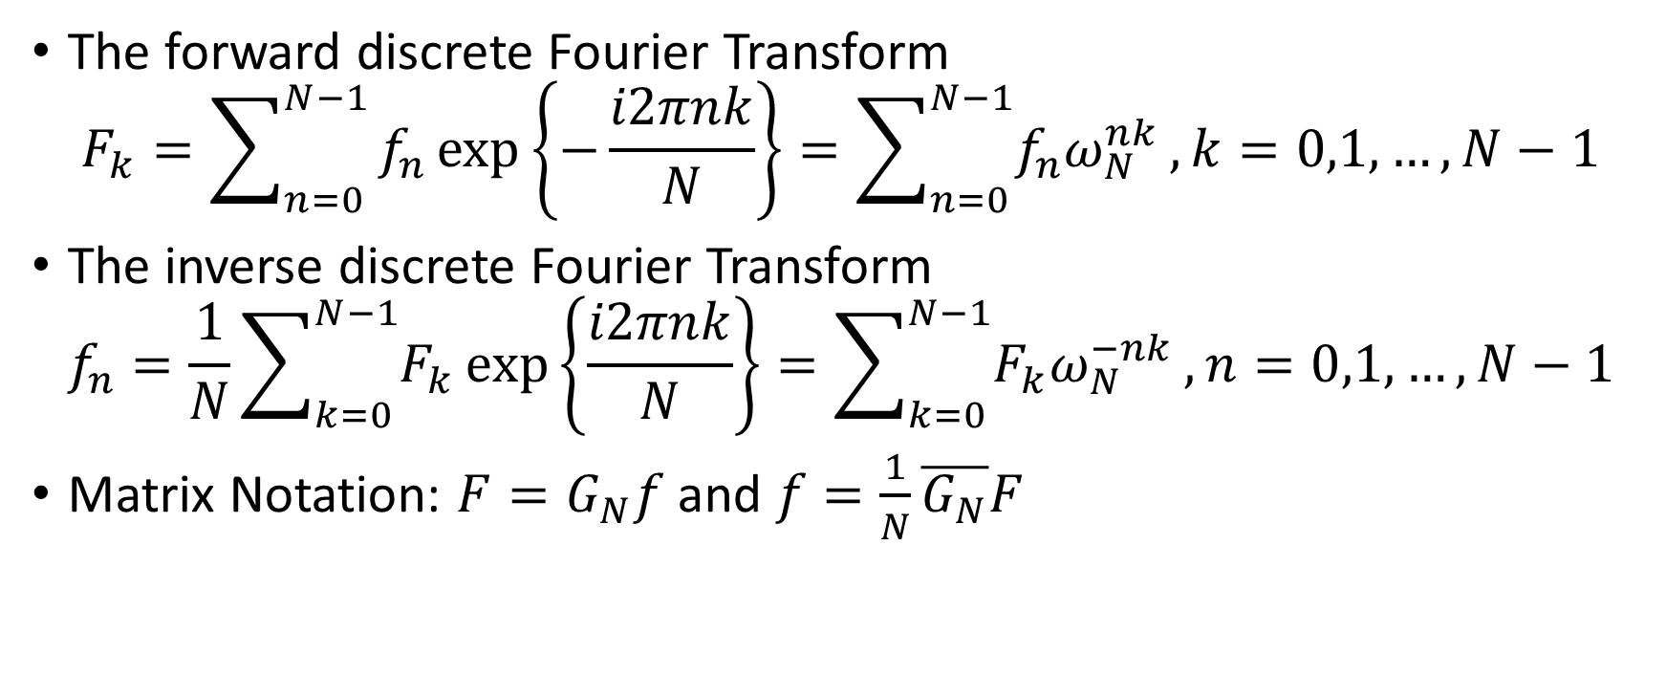
Summary
The forward discrete Fourier Transform
$$F_{k}=\sum_{n=0}^{N−1}{f_{n}\exp\left\{−\frac{i2πnk}{N}\right\}}=\sum_{n=0}^{N−1}{f_{n}ω_{N}^{nk}},k=0,1,…,N−1$$
The inverse discrete Fourier Transform
$$f_{n}=\frac{1}{N}\sum_{k=0}^{N−1}{F_{k}}\exp\left\{\frac{i2πnk}{N}\right\}=\sum_{k=0}^{N−1}{F_{k}ω_{N}^{−nk}},n=0,1,…,N−1$$
Matrix Notation: $F=G_{N}f$ and $f=\frac{1}{N}\overline{G_{N}}F$
But, what does this have to do with convolution?

Slide 5
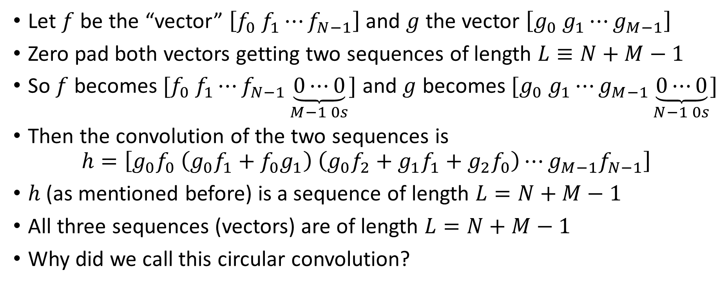
Circular Convolution
Let $f$ be the “vector” $\left[f_{0} f_{1}⋯f_{N−1}\right]$ and $g$ the vector $\left[g_{0} g_{1}⋯g_{M−1}\right]$
Zero pad both vectors getting two sequences of length $L≡N+M−1$
So $f$ becomes $[f_{0} f_{1}⋯f_{N−1}\underset{M−1 0s}{\underbrace{0⋯0}}]$ and $g$ becomes $[g_{0} g_{1}⋯g_{M−1}\underset{N−1 0s}{\underbrace{0⋯0}}]$
Then the convolution of the two sequences is
$$h=\left[g_{0}f_{0} \left(g_{0}f_{1}+f_{0}g_{1}\right) \left(g_{0}f_{2}+g_{1}f_{1}+g_{2}f_{0}\right)⋯g_{M−1}f_{N−1}\right]$$
$h$ (as mentioned before) is a sequence of length $L=N+M−1$
All three sequences (vectors) are of length $L=N+M−1$
Why did we call this circular convolution?

Slide 6

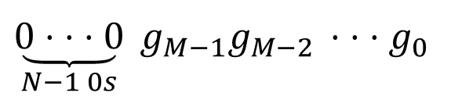
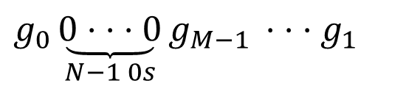

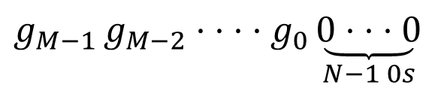

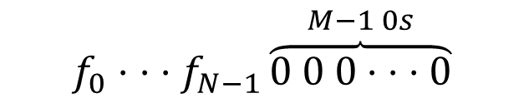


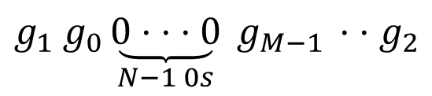

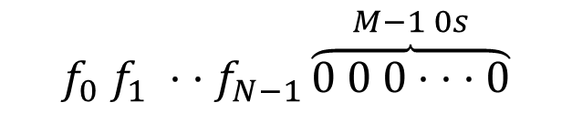
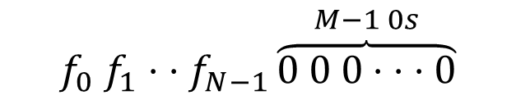


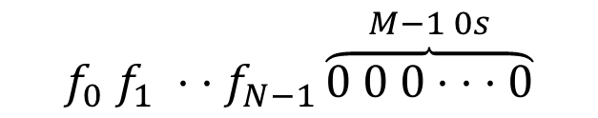
$$f_{0}⋅ ⋅ ⋅f_{N−1}\overset{M−1 0s}{\overbrace{0 0 0⋅ ⋅ ⋅0}}$$
$$f_{0}g_{0}$$
$g_{0}\underset{N−1 0s}{\underbrace{0⋅ ⋅ ⋅0}}g_{M−1 }⋅ ⋅ ⋅g_{1}$
$$f_{0} f_{1}⋅ ⋅f_{N−1}\overset{M−1 0s}{\overbrace{0 0 0⋅ ⋅ ⋅0}}$$
$$\left(f_{0}g_{1}+f_{1}g_{0}\right)$$
$g_{1} g_{0}\underset{N−1 0s}{\underbrace{0⋅ ⋅ ⋅0}} g_{M−1 }⋅ ⋅g_{2}$
$$⋅ ⋅ ⋅$$
$$⋅ ⋅ ⋅$$
$$f_{0} f_{1} ⋅ ⋅f_{N−1}\overset{M−1 0s}{\overbrace{0 0 0⋅ ⋅ ⋅0}}$$
$$\left(f_{0}g_{M−1}+⋯+f_{N−1}g_{M−N}\right)$$
$$g_{M−1 }g_{M−2}⋅ ⋅ ⋅ ⋅g_{0}\underset{N−1 0s}{\underbrace{0⋅ ⋅ ⋅0}}$$
$$⋅ ⋅ ⋅$$
$$⋅ ⋅ ⋅$$
$$f_{0} f_{1} ⋅ ⋅f_{N−1}\overset{M−1 0s}{\overbrace{0 0 0⋅ ⋅ ⋅0}}$$
$$f_{N−1}g_{M−1}$$
$\underset{N−1 0s}{\underbrace{0⋅ ⋅ ⋅0}} g_{M−1}g_{M−2 }⋅ ⋅ ⋅g_{0}$

Slide 7
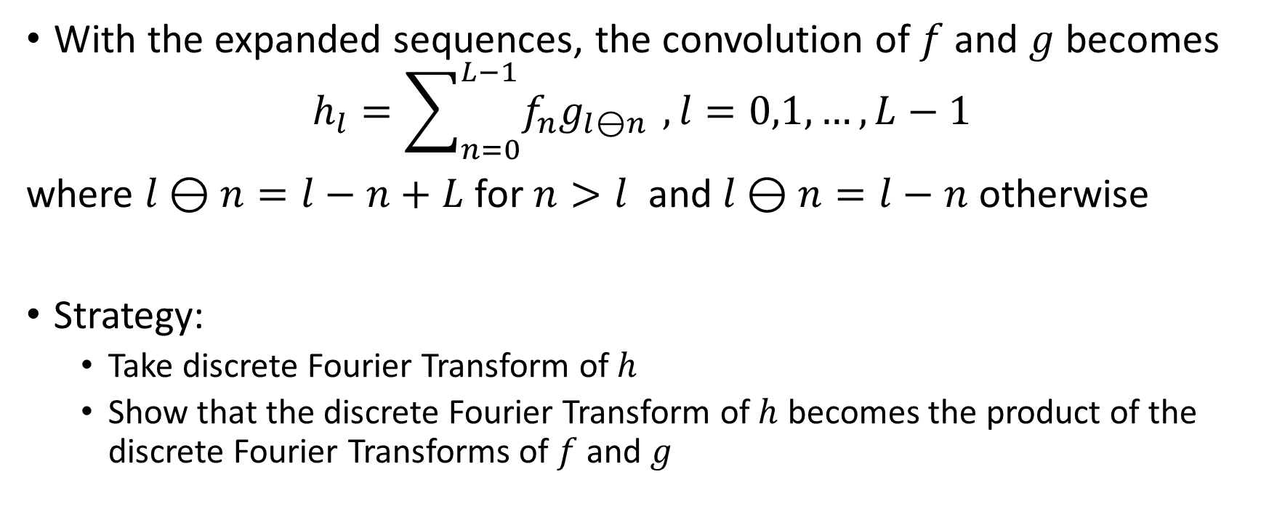
Circular Convolution (contd.)
With the expanded sequences, the convolution of $f$ and $g$ becomes
$$h_{l}=\sum_{n=0}^{L−1}{f_{n}g_{l⊖n }},l=0,1,…,L−1$$
where $l⊖n=l−n+L$ for $n>l$ and $l⊖n=l−n$ otherwise
Strategy:
Take discrete Fourier Transform of $h$
Show that the discrete Fourier Transform of $h$ becomes the product of the discrete Fourier Transforms of $f$ and $g$

Slide 8
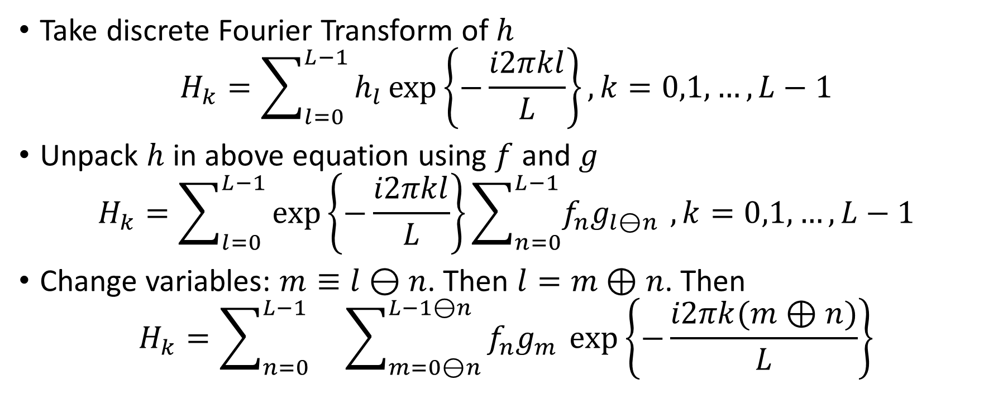
Circular Convolution and discrete Fourier Transform
Take discrete Fourier Transform of $h$
$$H_{k}=\sum_{l=0}^{L−1}{h_{l}\exp\left\{−\frac{i2πkl}{L}\right\}}, k=0,1,…,L−1$$
Unpack $h$ in above equation using $f$ and $g$
$$H_{k}=\sum_{l=0}^{L−1}{\exp\left\{−\frac{i2πkl}{L}\right\}}\sum_{n=0}^{L−1}{f_{n}g_{l⊖n }},k=0,1,…,L−1$$
Change variables: $m≡l⊖n$. Then $l=m⊕n$. Then
$$H_{k}=\sum_{n=0}^{L−1}{}\sum_{m=0⊖n}^{L−1⊖n}{f_{n}g_{m }\exp\left\{−\frac{i2πk(m⊕n)}{L}\right\}}$$

Slide 9
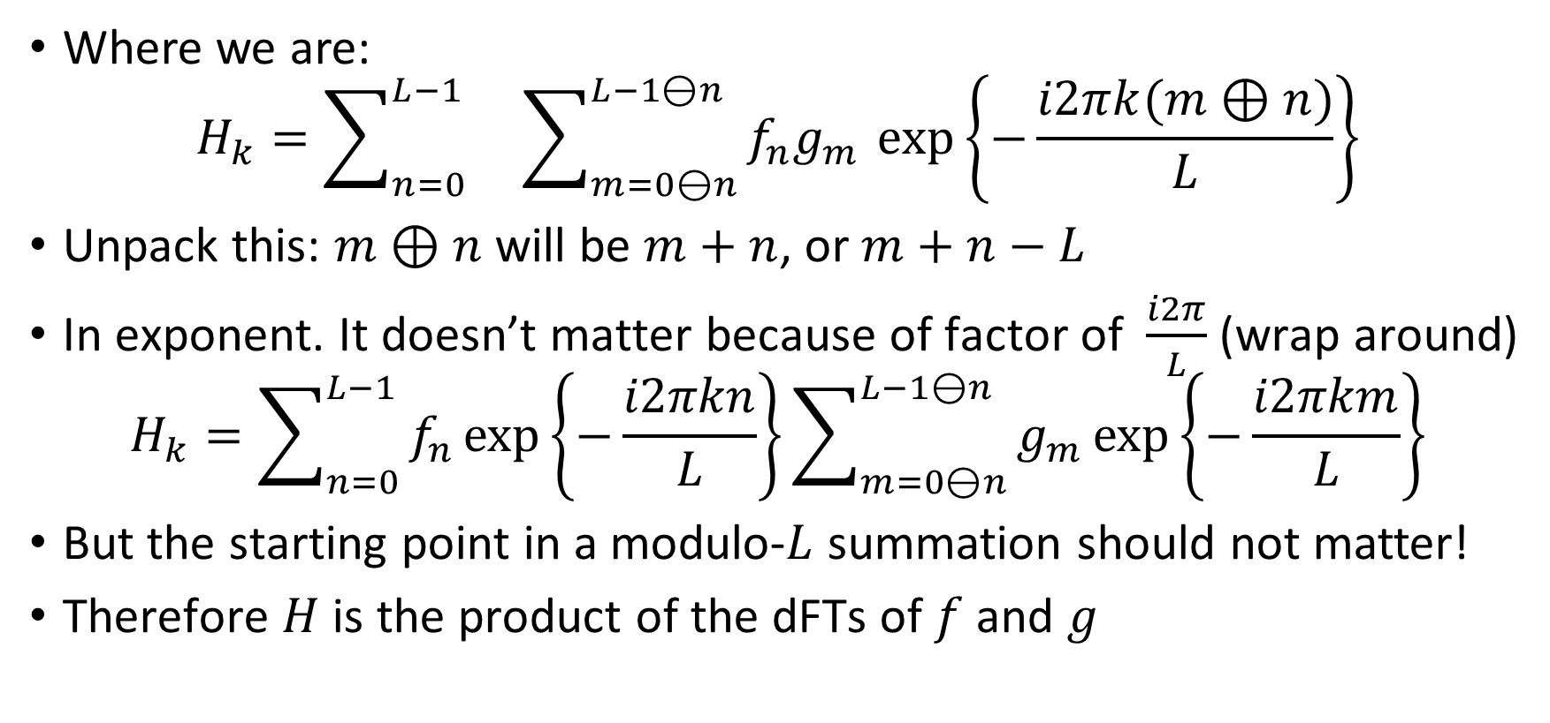
Circular Convolution (fini)
Where we are:
$$H_{k}=\sum_{n=0}^{L−1}{}\sum_{m=0⊖n}^{L−1⊖n}{f_{n}g_{m }\exp\left\{−\frac{i2πk(m⊕n)}{L}\right\}}$$
Unpack this: $m⊕n$ will be $m+n$, or $m+n−L$
In exponent. It doesn’t matter because of factor of $\frac{i2π}{L}$ (wrap around)
$$H_{k}=\sum_{n=0}^{L−1}{f_{n}\exp\left\{−\frac{i2πkn}{L}\right\}}\sum_{m=0⊖n}^{L−1⊖n}{g_{m}\exp\left\{−\frac{i2πkm}{L}\right\}}$$
But the starting point in a modulo-$L$ summation should not matter!
Therefore $H$ is the product of the dFTs of $f$ and $g$

Slide 10
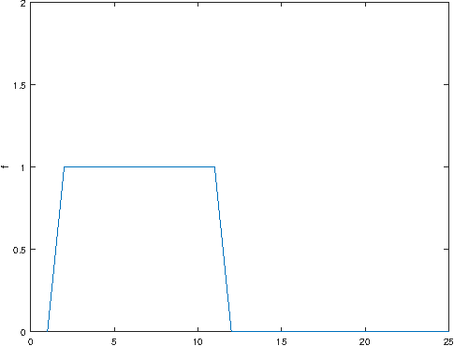
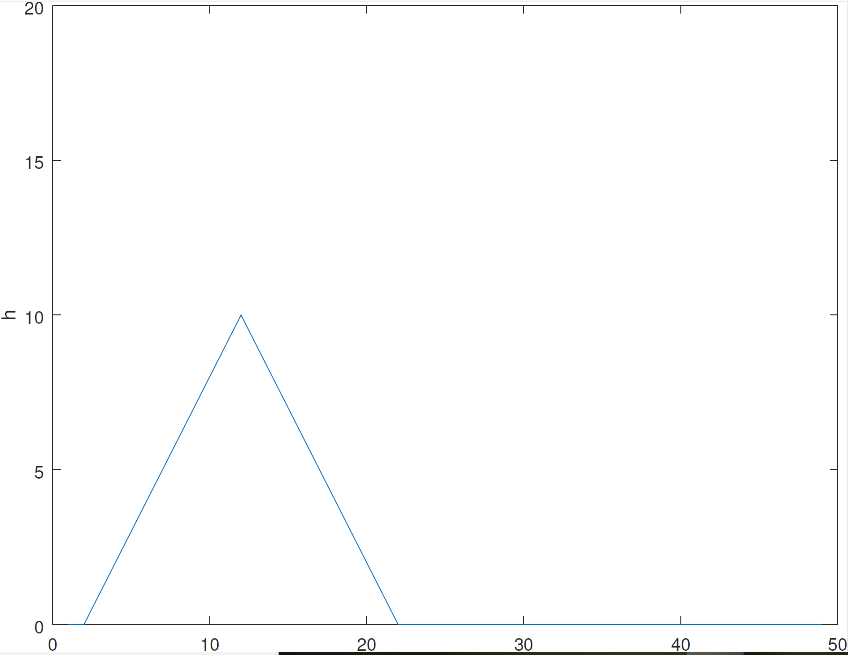
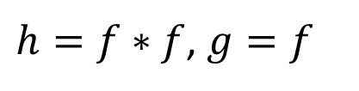
Convolution and Discrete Fourier Transform
$h=f∗f$, $g=f$

Slide 11
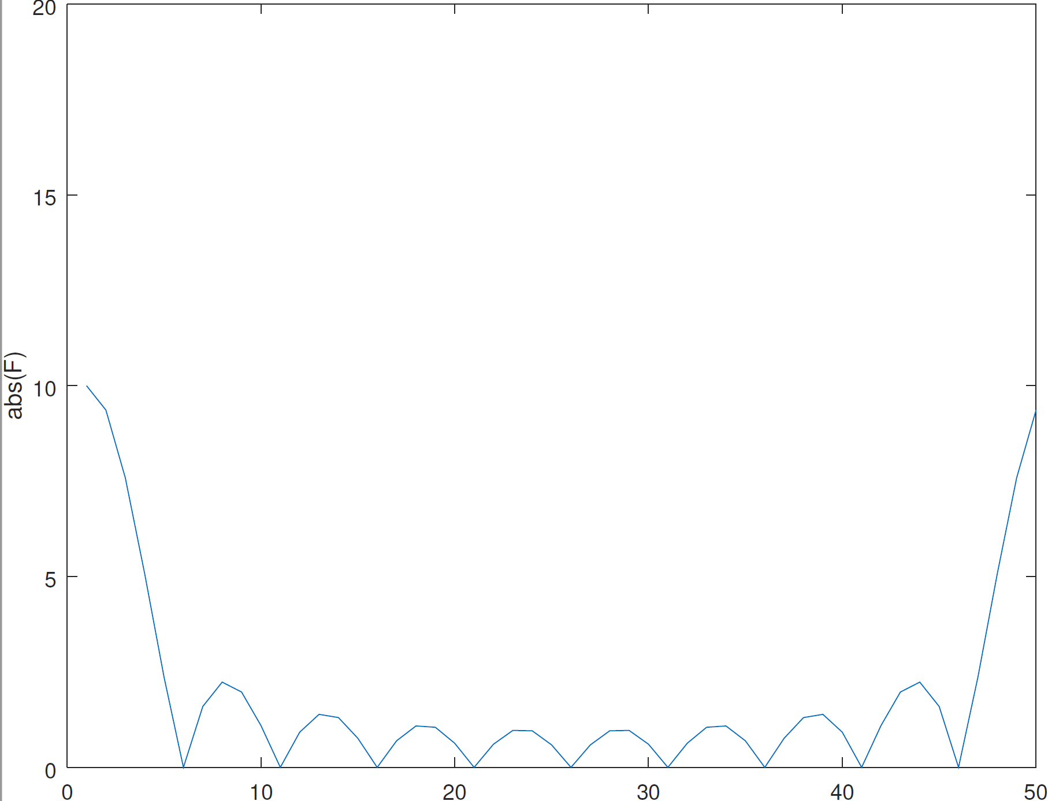
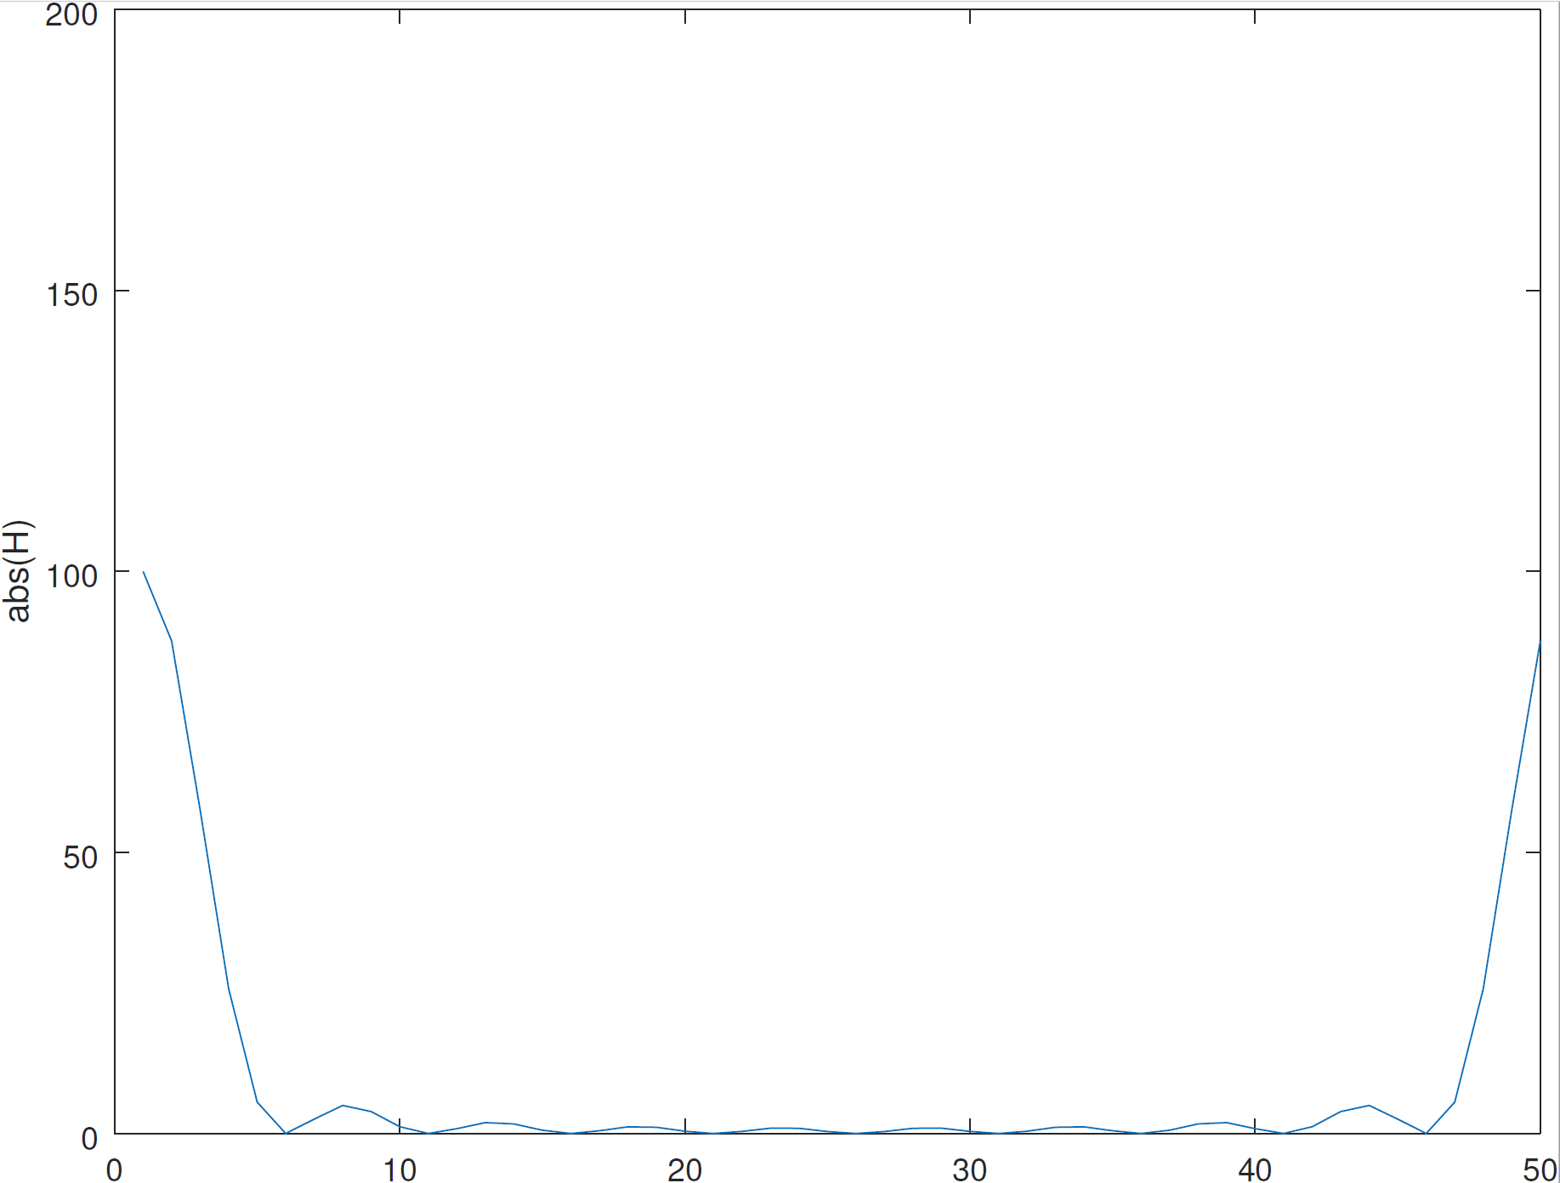
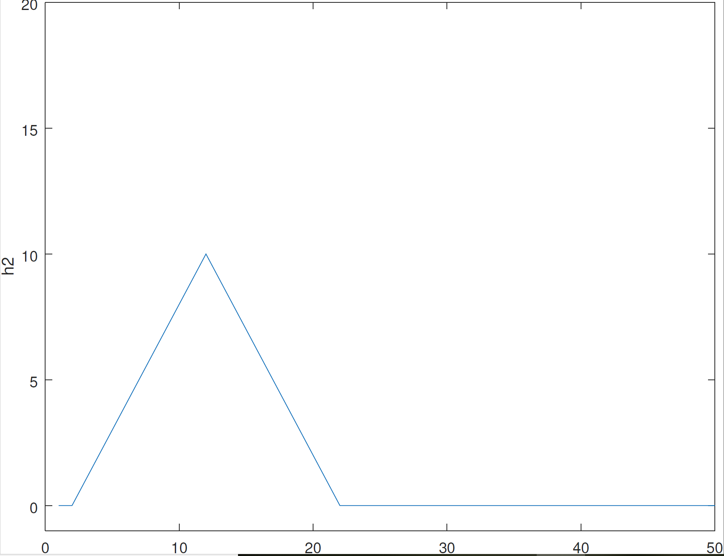

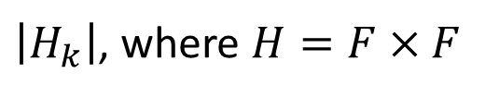

Convolution and Discrete Fourier Transform (contd.)
$$h=IFFT(H)$$
$$\left|F_{k}\right|$$
$\left|H_{k}\right|$, where $H=F×F$

Slide 12
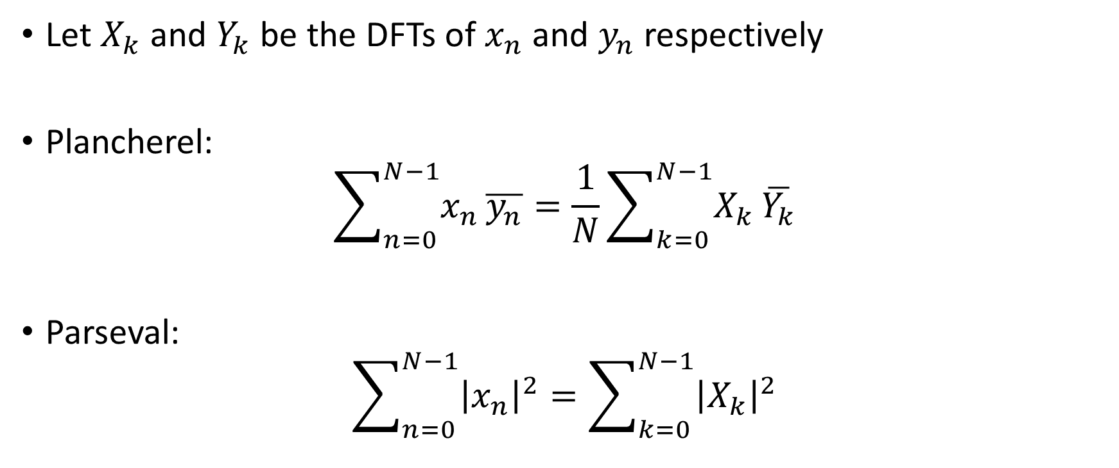
Plancherel and Parseval
Let $X_{k}$ and $Y_{k}$ be the DFTs of $x_{n}$ and $y_{n}$ respectively
Plancherel:
$$\sum_{n=0}^{N−1}{x_{n}}\overline{y_{n}}=\frac{1}{N}\sum_{k=0}^{N−1}{X_{k}}\overline{Y_{k}}$$
Parseval:
$$\sum_{n=0}^{N−1}{{\left|x_{n}\right|}^{2}}=\sum_{k=0}^{N−1}{{\left|X_{k}\right|}^{2}}$$

Slide 13
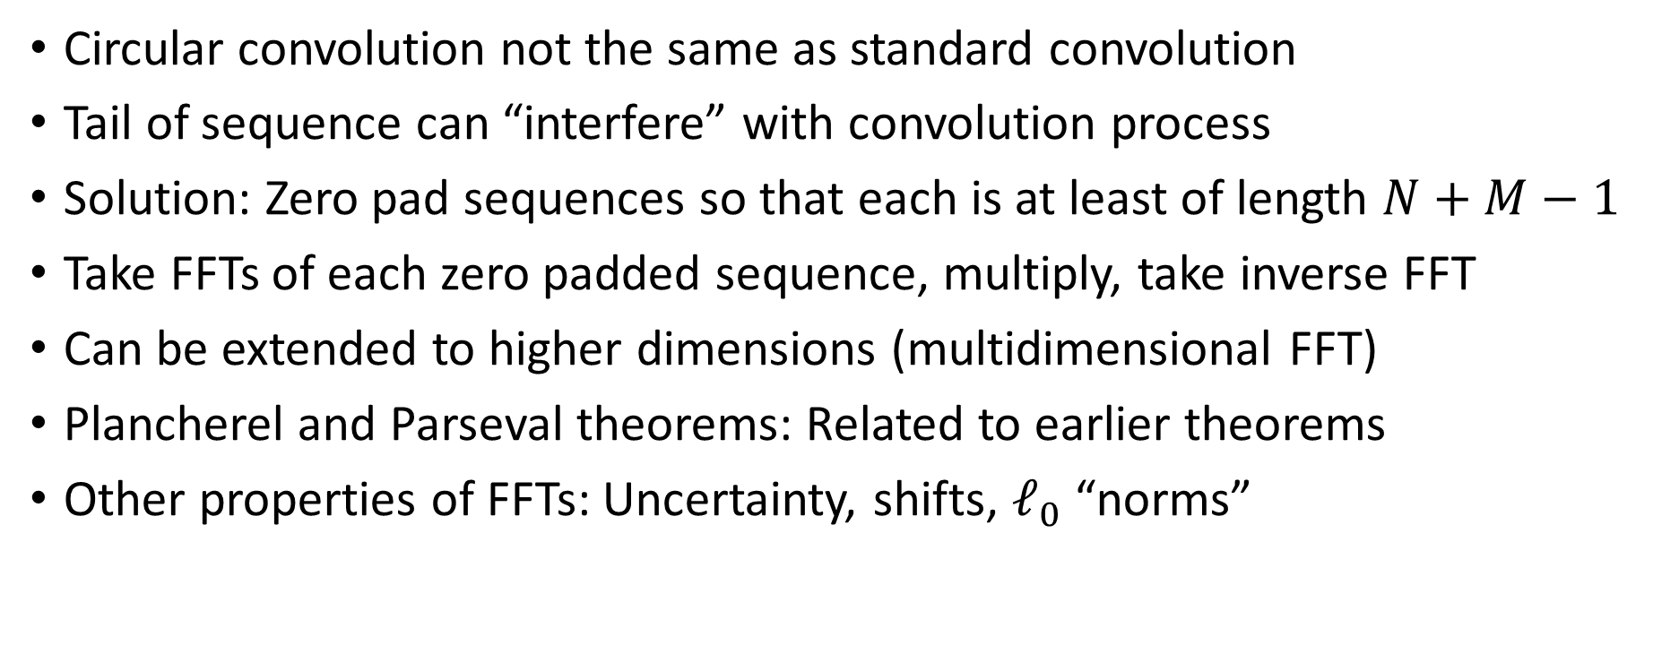
Summary
Circular convolution not the same as standard convolution
Tail of sequence can “interfere” with convolution process
Solution: Zero pad sequences so that each is at least of length $N+M−1$
Take FFTs of each zero padded sequence, multiply, take inverse FFT
Can be extended to higher dimensions (multidimensional FFT)
Plancherel and Parseval theorems: Related to earlier theorems
Other properties of FFTs: Uncertainty, shifts, $ℓ_{0}$ “norms”

